Slide 1
Machine Learning Learnings
From perceptron to object detection

Slide 2
Table of Contents
Perceptron
Biological representation
Artificial representation
Feed-forward
Classification
Regression

Slide 3
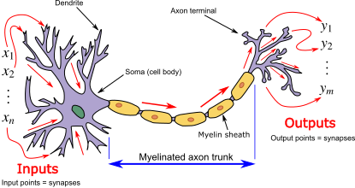
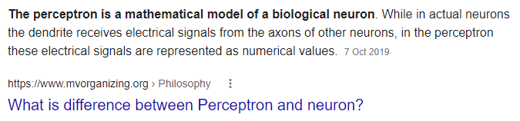
Perceptron? Neuron?
(Insert mandatory biological neuron explanation)

Slide 4

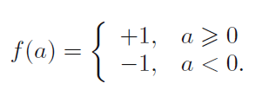



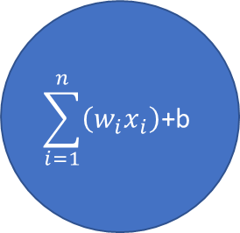



Linear perceptron
bias
$$w_{0}$$
$$\sum_{i=1}^{n}{\left(w_{i}x_{i}\right)\text{+}\text{b}}$$
$$w_{1}$$
$$x_{1}$$
classification
$$w_{2}$$
$$x_{2}$$
$$w_{0}+w_{1}x_{1}+w_{2}x_{2}=0$$

Slide 5
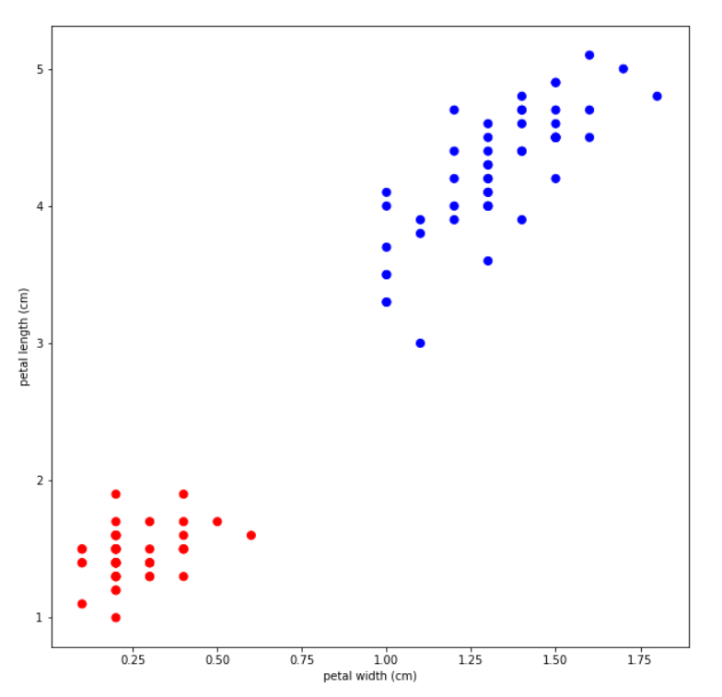
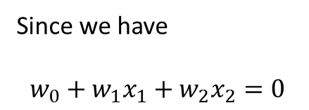
Line which best splits the two classes
Since we have
$$w_{0}+w_{1}x_{1}+w_{2}x_{2}=0$$

Slide 6
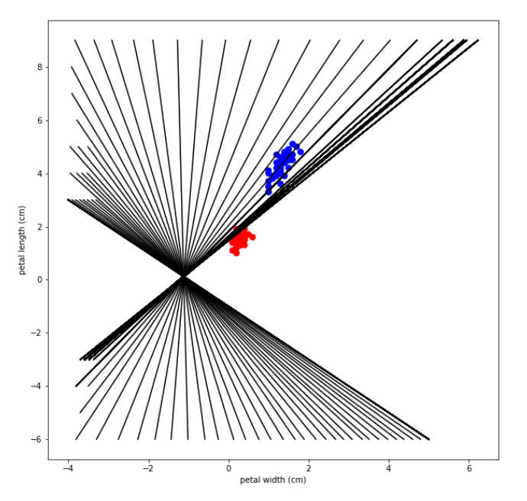
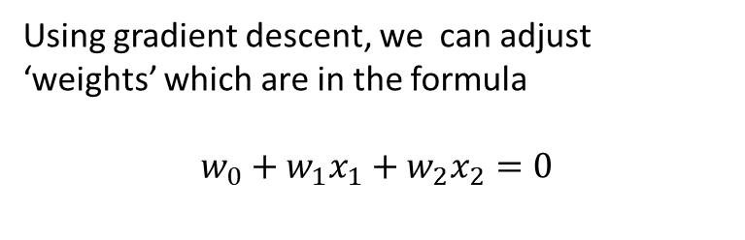

Linear discriminants
Using gradient descent, we can adjust ‘weights’ which are in the formula
$$w_{0}+w_{1}x_{1}+w_{2}x_{2}=0$$
Discriminant can be plotted as
$$x_{1}=\frac{w_{2}x_{2}+w_{0}}{w_{1}}$$

Slide 7




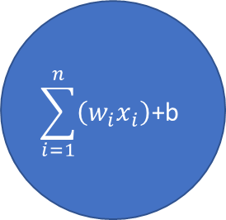

Regression
bias
$$w_{0}$$
$$\sum_{i=1}^{n}{\left(w_{i}x_{i}\right)\text{+}\text{b}}$$
$$w_{1}$$
$$w_{0}+w_{1}x_{1}+w_{2}x_{2}=target$$
$$x_{1}$$
$$w_{2}$$
$$x_{2}$$

Slide 8
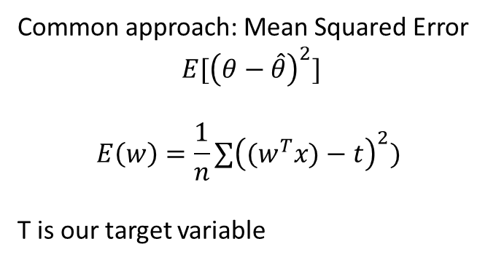
$$w_{0}+w_{1}x_{1}=target$$
Line which would fit best?
We can implement ‘cost function’
Thing that we are trying to minimize
Common approach: Mean Squared Error
$$E[{\left(θ−\hat{θ}\right)}^{2}]$$
$$E\left(w\right)=\frac{1}{n}∑{\left({(w}^{T}x)−t\right)}^{2})$$
T is our target variable

Slide 9
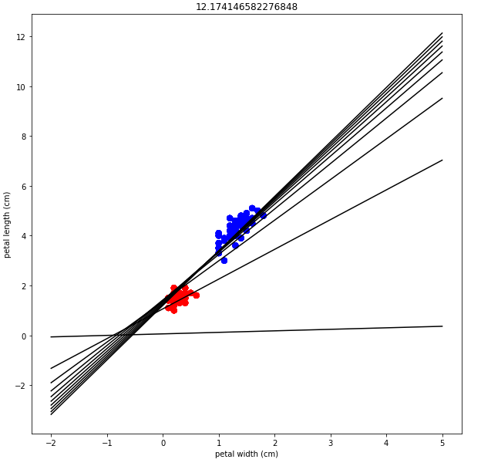
300 iterations (weight updates) with learning rate 0.01
But how does it work??!

Slide 10
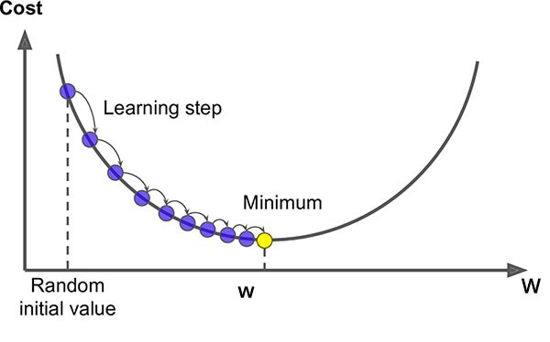
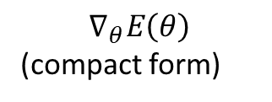
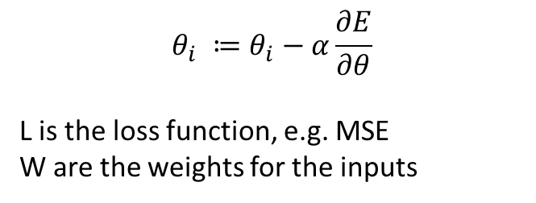

Gradient descent
$$θ_{i} ≔θ_{i}−α\frac{∂E}{∂θ}$$
L is the loss function, e.g. MSE
W are the weights for the inputs
$$∇_{θ}E\left(θ\right)$$
(compact form)
$$E\left(w\right)=\frac{1}{n}∑{\left(\left(w^{T}x\right)−t\right)}^{2})$$
$\frac{∂E}{∂w_{0}}=\frac{2}{n}∗{(w}^{T}x −t) ∗1$
$\frac{∂E}{∂w_{1}}=\frac{2}{n}∗{(w}^{T}x −t)∗x_{1}$
…
$$w_{0}+w_{1}x_{1}+w_{2}x_{2}=target$$
That’s why its better to normalize data

Slide 11

def mse_gd(x, theta, t, alpha):
n = len(x)
theta -= alpha * (2/n * (theta.dot(x.T) - t) * x)
return theta
def gradient_descent(x, theta, alpha, err):
theta += alpha * (err) * x # err <- (expected – predicted)
return theta
(!) Data in the form of [1., data column] for x (1 is for the bias weight)
(!) There are multiple ways to initialize theta’s (weights)
Simply all weights to 0
Random initialization
(advanced/used for NN) Xavier initialization (also called Glorot)
(advanced/used for NN) He initialization

Slide 12
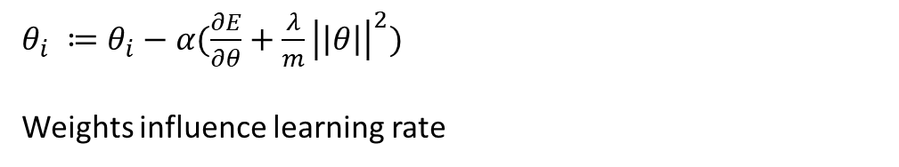

Gradient descent (more advanced)
A simple normal gradient descent is too simple..
L1 reguralization –
L2 reguralization -
Also.. To name a few optimizers…
RMSProp
Adam Optimizer
Sgd + momentum optimizer
$θ_{i} ≔θ_{i}−α(\frac{∂E}{∂θ}+\frac{λ}{m}∑\left|θ\right|)$
penalty
$θ_{i} ≔θ_{i}−α(\frac{∂E}{∂θ}+\frac{λ}{m}{\left|\left|θ\right|\right|}^{2})$
Weights influence learning rate

Slide 13
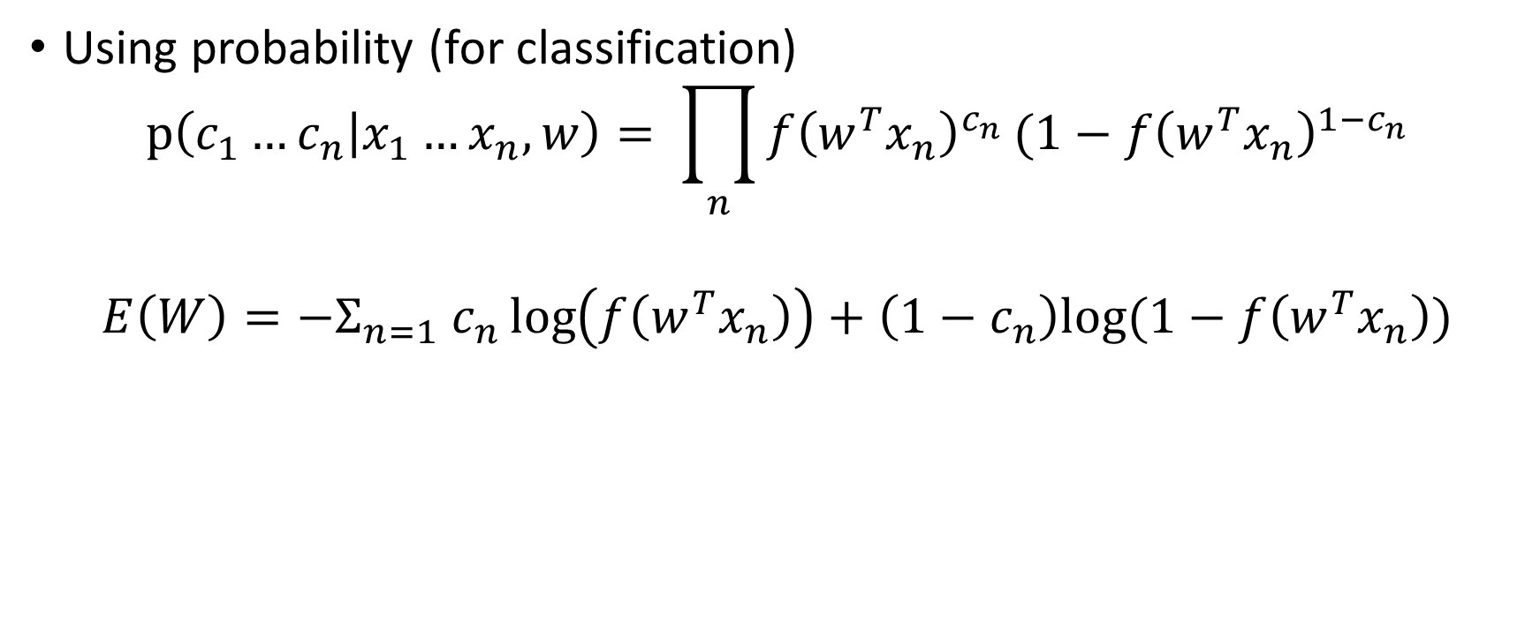
Cost functions (also called loss function or error function)
Using probability (for classification)
$$p\left(c_{1}…c_{n} | x_{1}…x_{n},w\right)= \prod_{n}{f{\left(w^{T}x_{n}\right)}^{c_{n}}}(1−f{\left(w^{T}x_{n}\right)}^{1−c_{n}}$$
$${E\left(W\right)=−Σ}_{n=1} c_{n}\log\left(f\left(w^{T}x_{n}\right)\right)+\left(1−c_{n}\right)log⁡(1−f\left(w^{T}x_{n}\right))$$

Slide 14
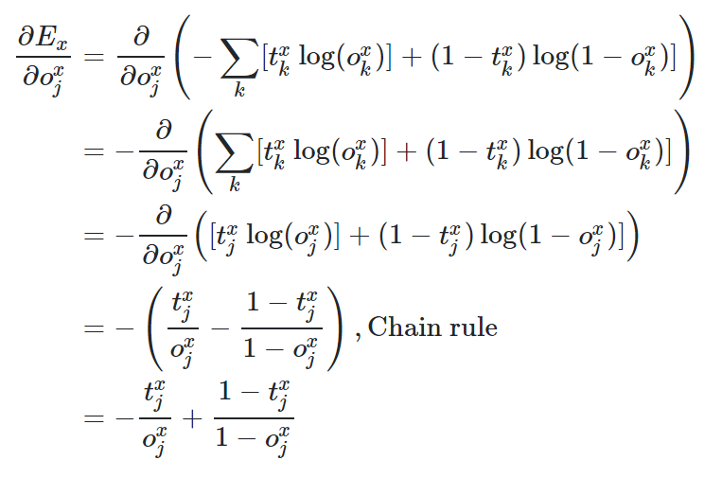

Slide 15
Cost function / Gradient descent
Simple regression example using probably MSE?
Representation learning (?)
Dropout (?)
But real world is not that straightforward
Mention reguralizations/different cost functions

Slide 16
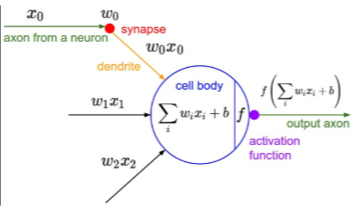
Introducing non-linearity
ReLU/Sigmoid/TanH/ etc…
bias
Activation
function

Slide 17
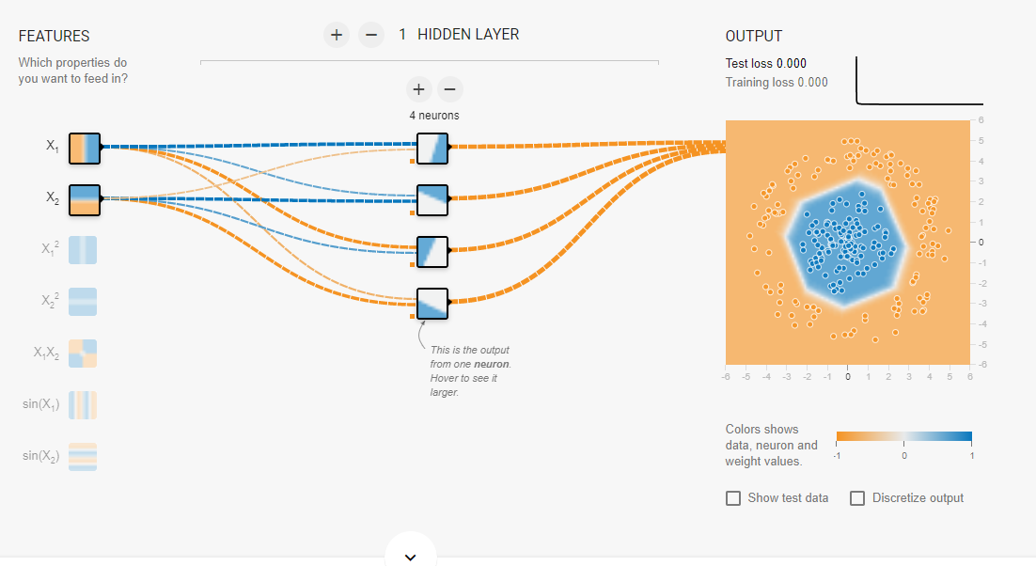
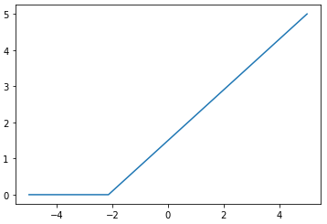
Multilayer perceptron
IN
F(x)

Slide 18
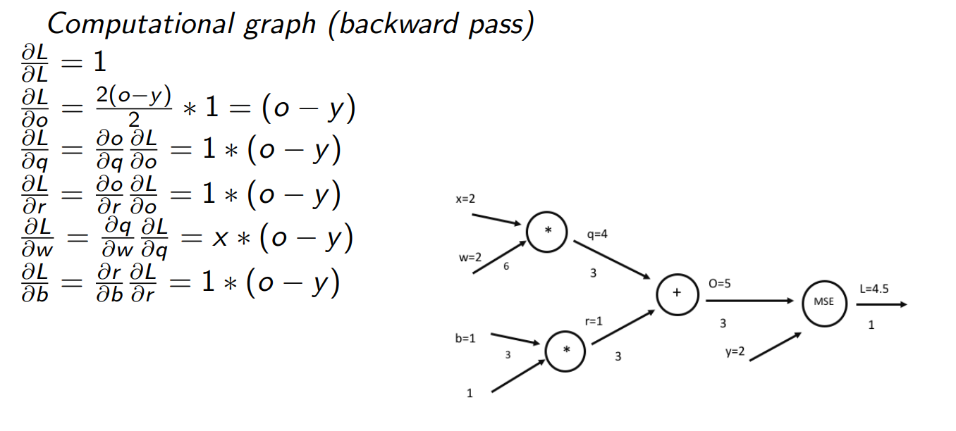
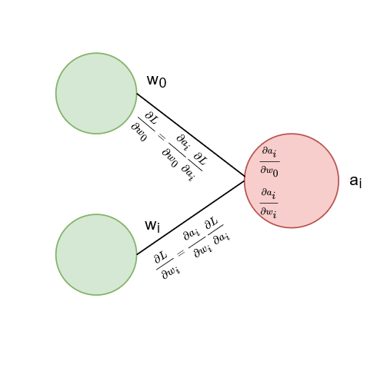

Slide 19
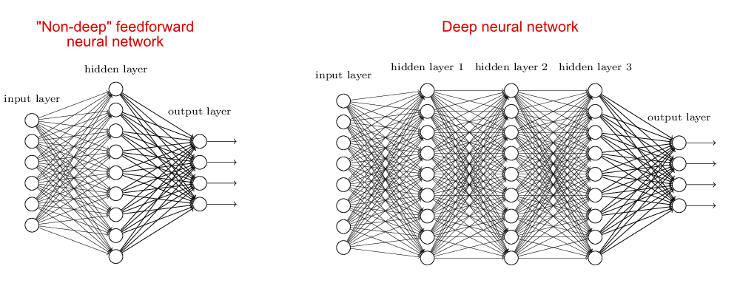
(Deep) Neural Networks
https://stats.stackexchange.com/questions/315402/multi-layer-perceptron-vs-deep-neural-network

Slide 20
Image classification
Why not use NN
Insert gif

Slide 21
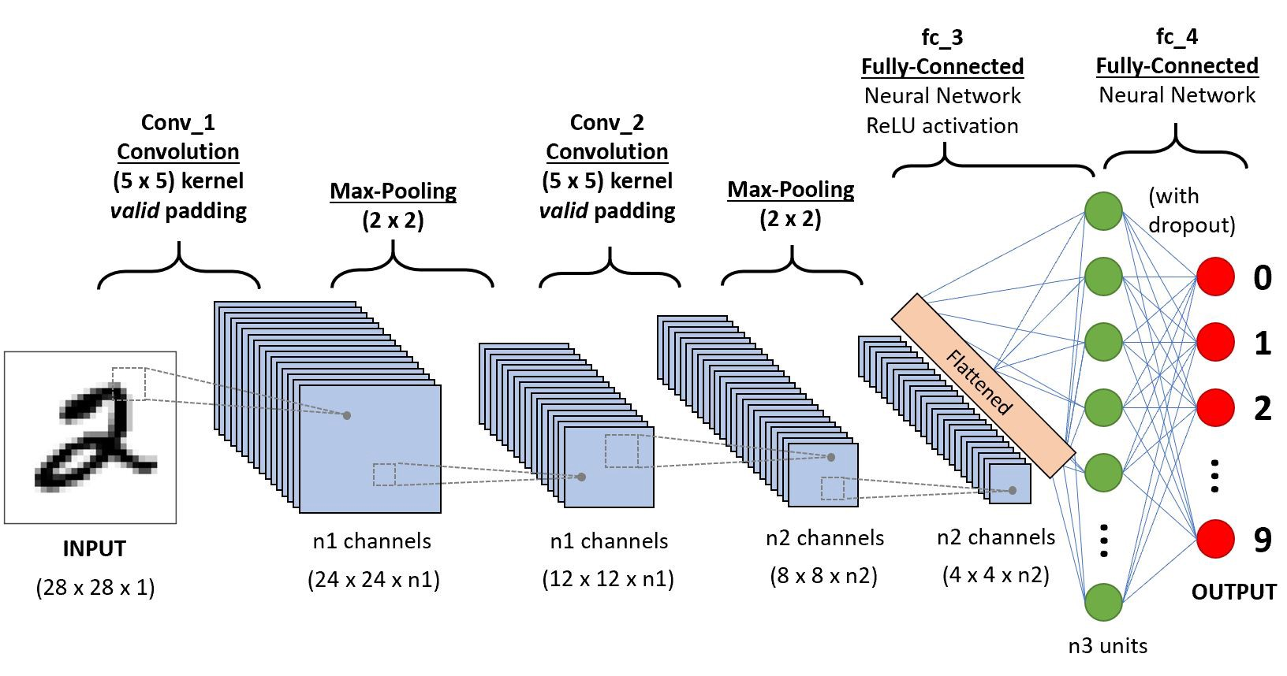
Convolutional Neural Network
Source: https://towardsdatascience.com/a-comprehensive-guide-to-convolutional-neural-networks-the-eli5-way-3bd2b1164a53

Slide 22
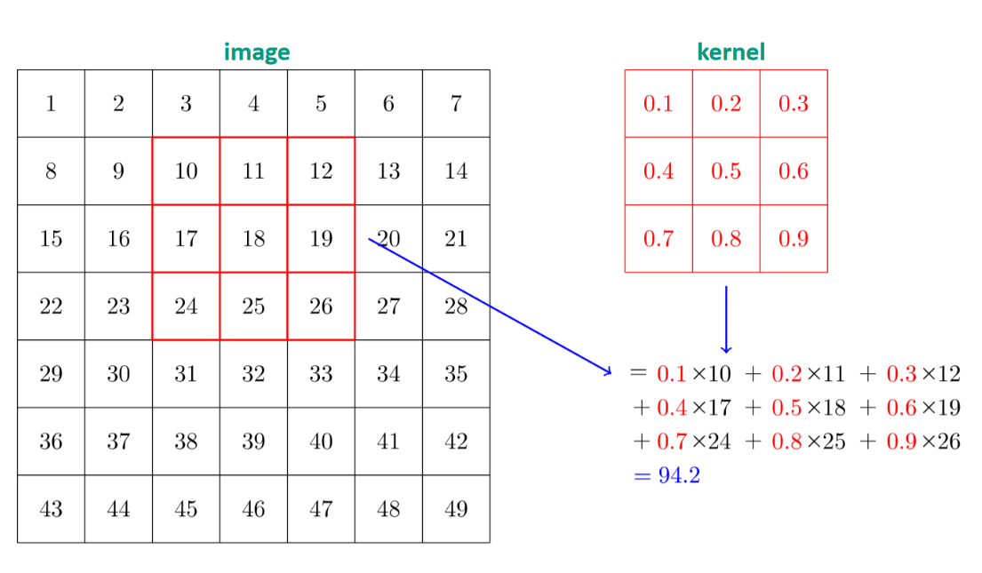
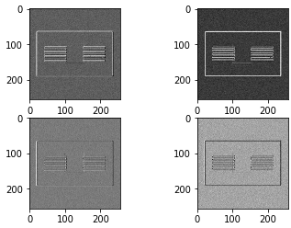

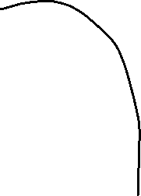
Convolutions
Maxpooling
Feature map
At the last layer of the architecture, it might look something like this…

